Slide 1

Internship studio project submission
Aryan Tokas
aryantokas8@gmail.com
+91 8800871609

Slide 2
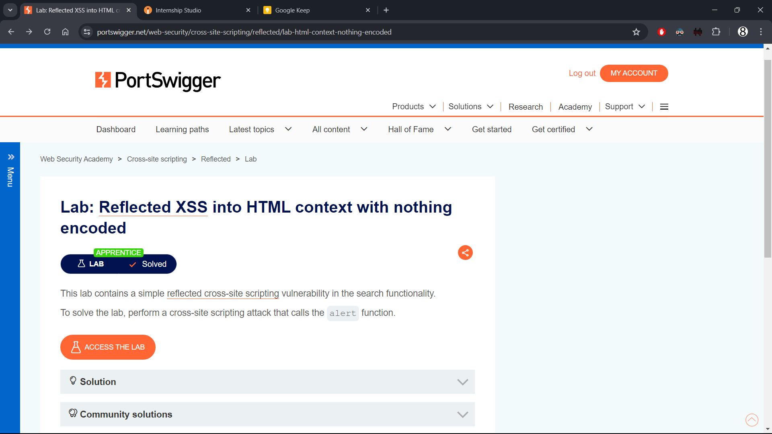

Slide 3
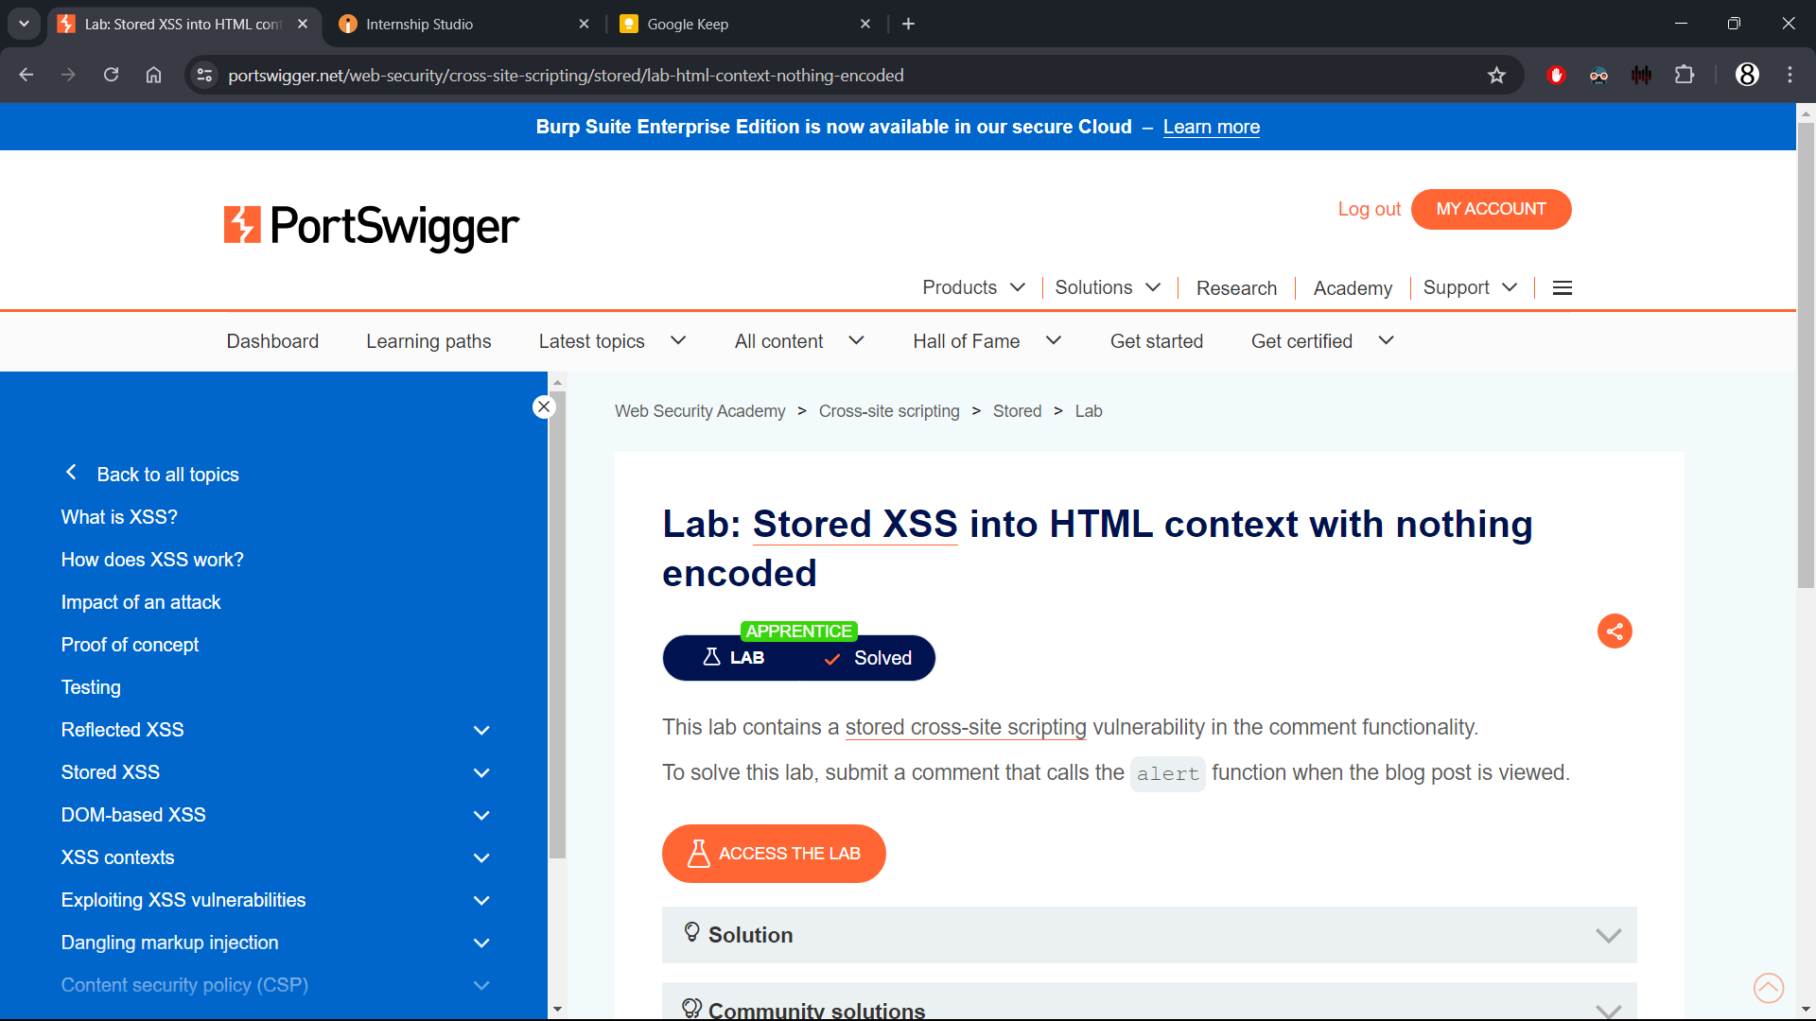

Slide 4
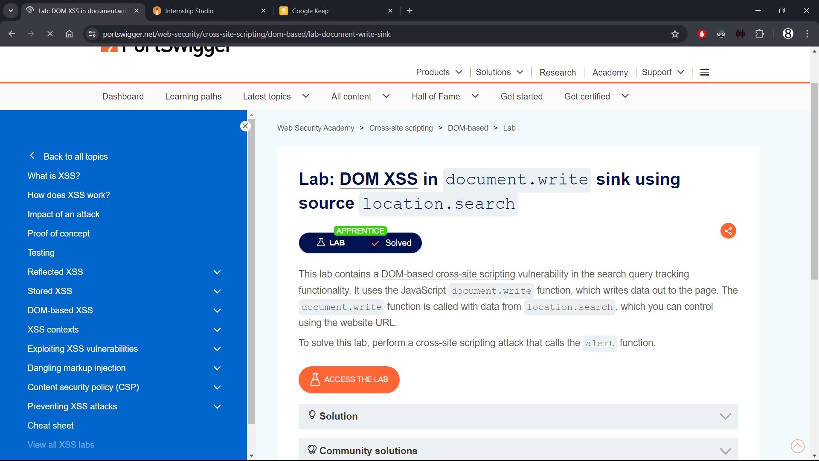

Slide 5
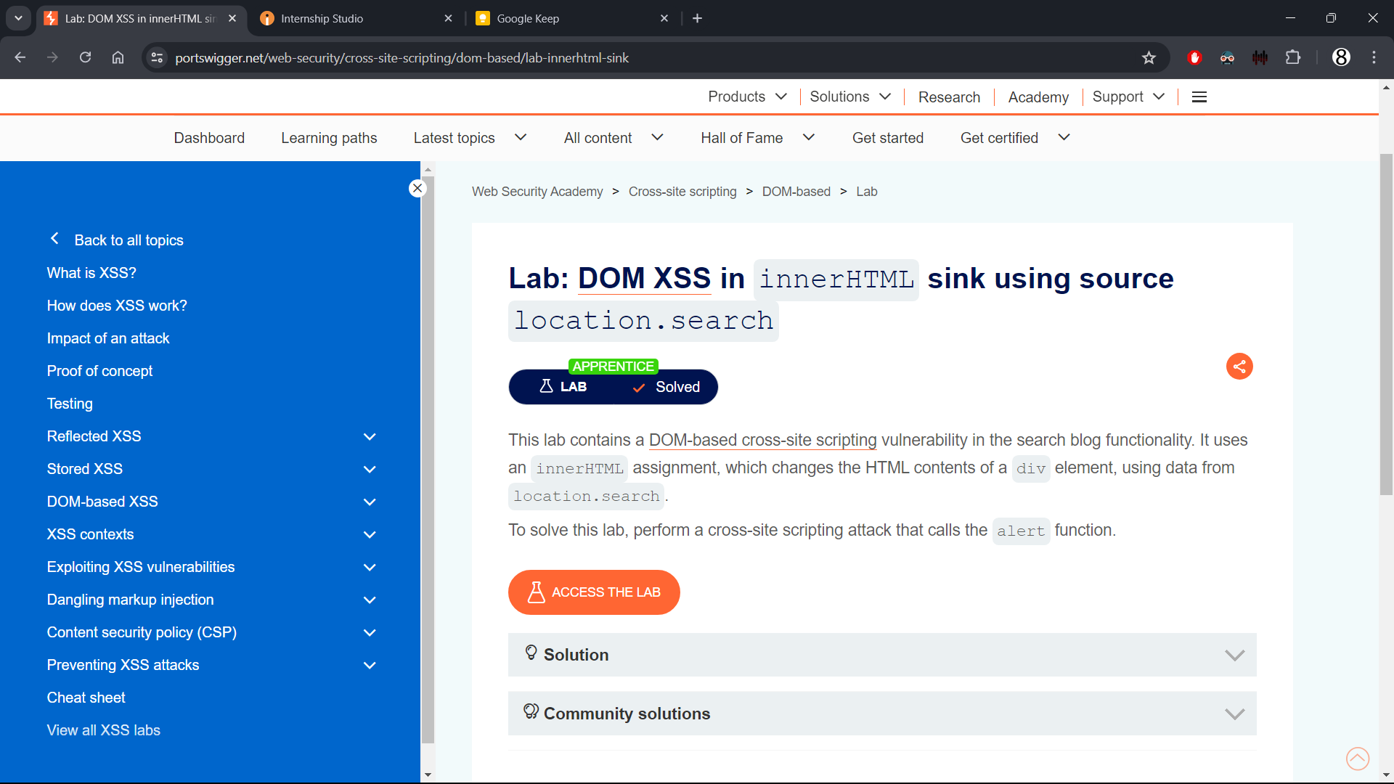

Slide 6
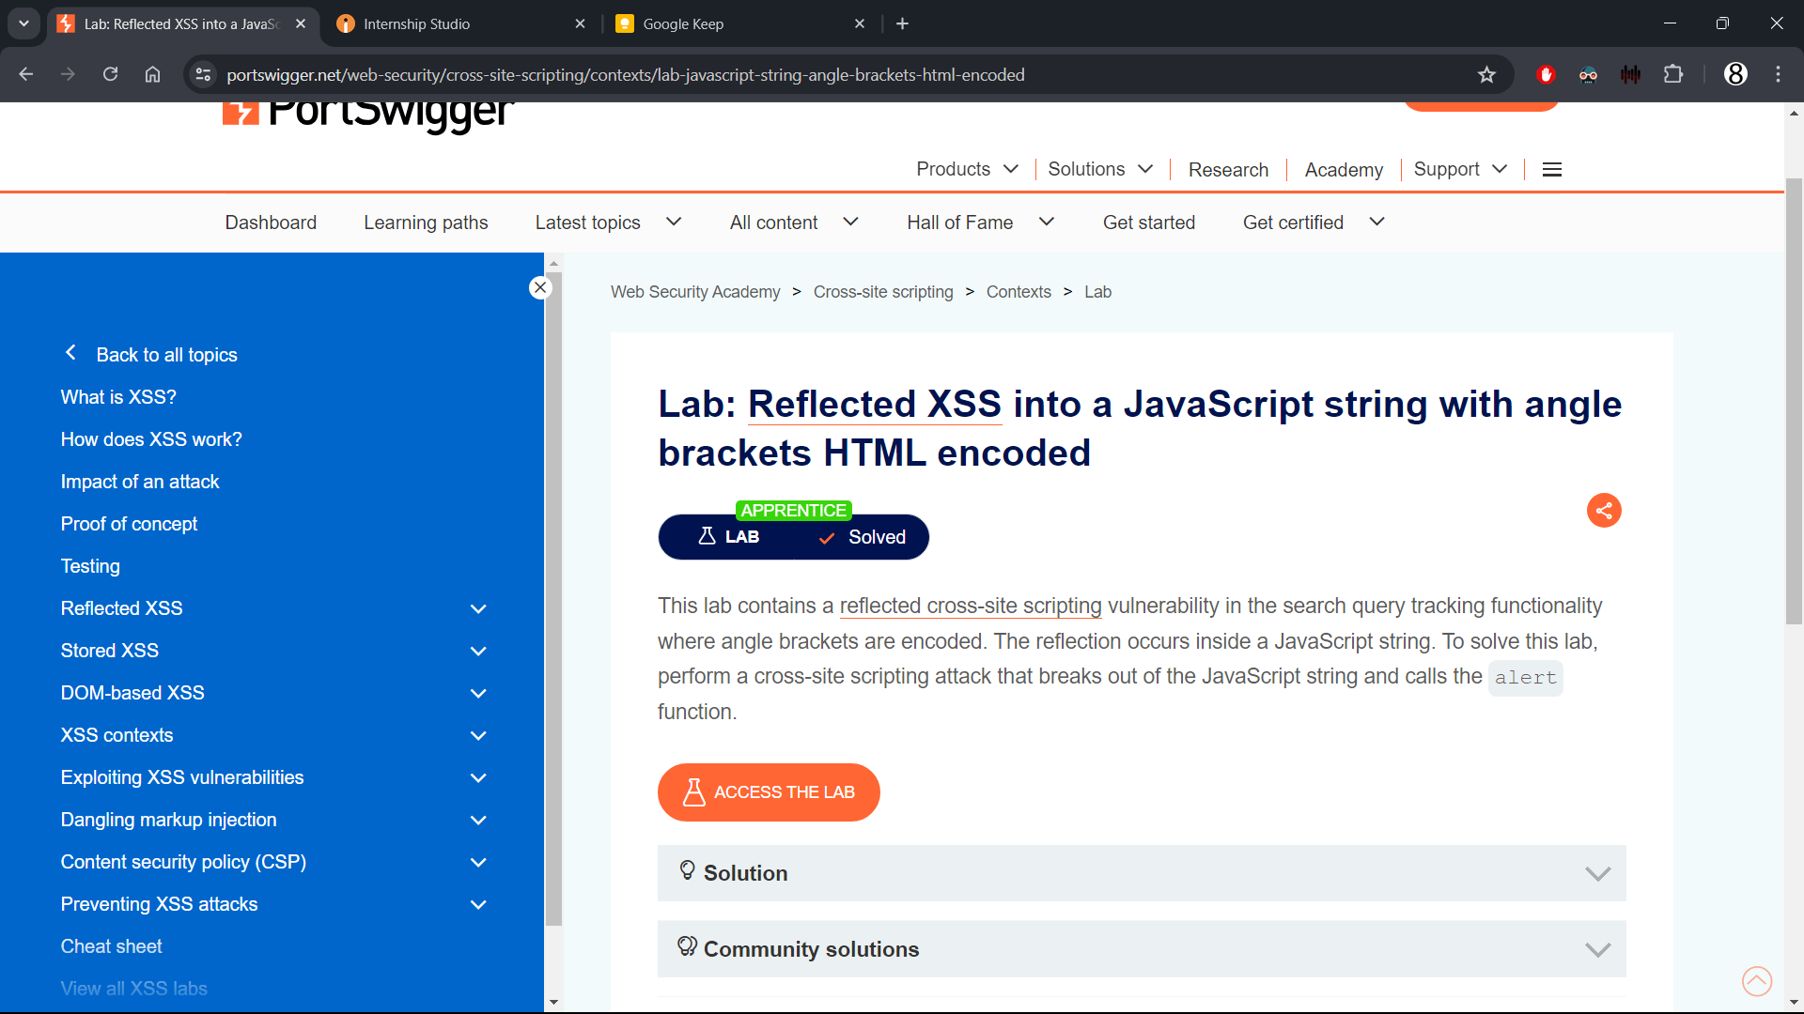

Slide 7
THANK YOU!

